Slide 1
How to define a fulfillment unit rule for a specific time period loan with an Overdue Fine
Yoel Kortick
Senior Librarian

Slide 2

Agenda
Introduction
The configuration - step 1
The configuration - step 2
The configuration - step 3
The configuration - step 4
The configuration - step 5
Test the Fulfillment Unit rule

Slide 3
Introduction

Slide 4
Introduction
In the example here we will make a loan policy of a "1 minute loan".
While in the "real world" there may not be situations of a "1 minute loan" we will be doing this for multiple reasons:
This will allow is to see what happens when the item is overdue without needing to wait for a more "standard" period of time.
This will allow us to see how fines are accrued when the item is overdue without needing to wait for a more "standard" period of time.
In any case the same flow here is used for other more "standard" periods of time such as "1 day" or "1 week".

Slide 5
Introduction
The steps we will follow are:
Define an "advanced policy configuration" of type "Due Date" called "1 minute loan"
Define an "advanced policy configuration" of type "Overdue Fine" called "1 minute Overdue Fine all minutes"
Make a Terms of Use of type "Loan" called "1 minute loan with fine on all minutes". It will use "advanced policy configurations" made above of type "Due Date" and "Overdue Fine"
Create an Item Policy called "1 Minute Loan With Overdue Fine"
Make a fulfillment unit rule which uses the above terms of use "1 minute loan with fine on all minutes"
Test the fulfillment unit rule by loaning an item which has Item Policy called "1 Minute Loan With Overdue Fine", wait for it to be overdue, check the fines.

Slide 6
The configuration - step 1

Slide 7
The configuration - step 1
Step 1: Define an "advanced policy configuration" of type "Due Date" called "1 minute loan"
This is done at "Configuration > Fulfillment > Physical Fulfillment > Advanced Policy Configuration > Add Fulfillment Policy > Choose Type 'Due Date' > Click 'Next'".
We receive the "Policy Details" page which appears on the next screen.

Slide 8
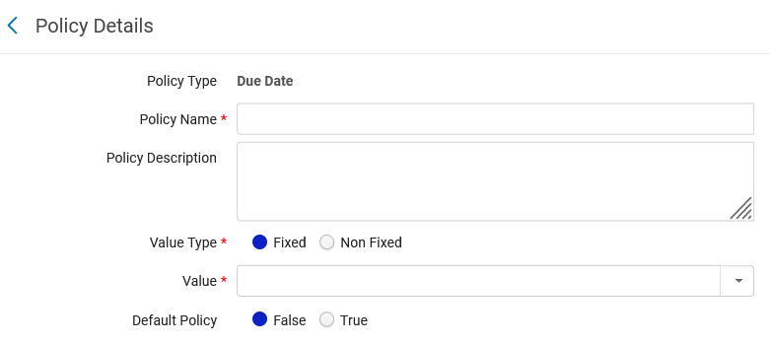
The configuration - step 1

Slide 9
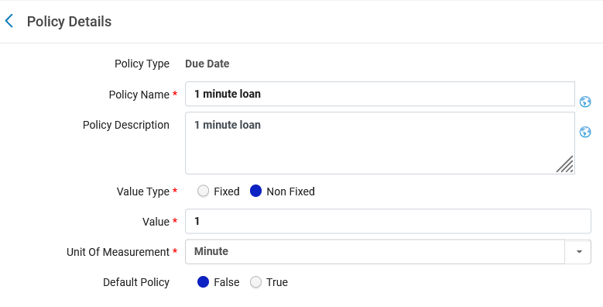
The configuration - step 1
We will fill in the Policy Details as follows:
We have chosen Value Type "Non Fixed" with a value of "1" Unit of Measurement and the Unit of Measurement is "Minute"
Value type "Fixed" is used if we want to choose a fixed date based on an event in the Institution Calendar.

Slide 10
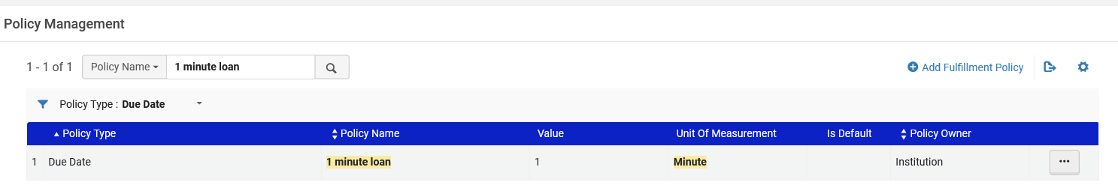
The configuration - step 1
We have done step 1 and defined an "advanced policy configuration" of type "Due Date" called "1 minute loan"

Slide 11
The configuration - step 2

Slide 12
The configuration - step 2
Step 2: Define an "advanced policy configuration" of type "Overdue Fine" called "1 minute Overdue Fine all minutes"
This is done at "Configuration > Fulfillment > Physical Fulfillment > Advanced Policy Configuration > Add Fulfillment Policy > Choose Type 'Overdue Fine' > Click 'Next'".
We receive the "Policy Details" page which appears on the next screen.

Slide 13
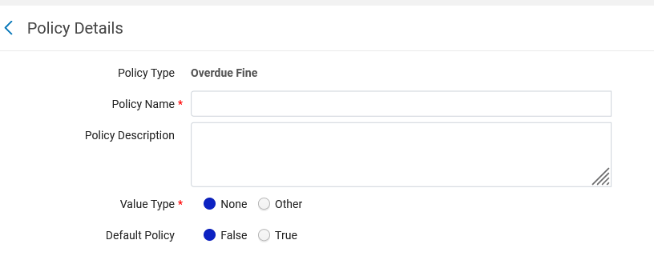
The configuration - step 2

Slide 14
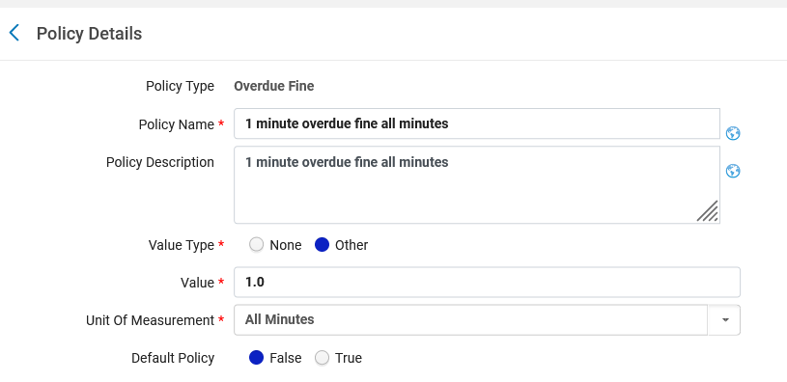
The configuration - step 2
We will fill in the Policy Details as follows:
We have defined a Value of "1.0" (units of currency) with a Unit of Measurement (from a predefined pull-down box) of "All Minutes"

Slide 15
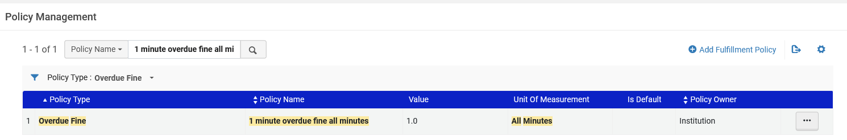
The configuration - step 2
We have done step 2 and defined an "advanced policy configuration" of type "Overdue Fine" called "1 minute Overdue Fine all minutes"

Slide 16
The configuration - step 3

Slide 17
The configuration - step 3
Step 3: Make a Terms of Use of type "Loan" called "1 minute loan with fine on all minutes". It will use "advanced policy configurations" made above of type "Due Date" and "Overdue Fine"
This is done at "Configuration > Fulfillment > Physical Fulfillment > Terms of Use and Policies > Add a Terms Of Use > Choose Terms of Use type 'Loan' > Click 'Next'".
We receive the "Terms of Use Management" page which appears on the next screen.

Slide 18
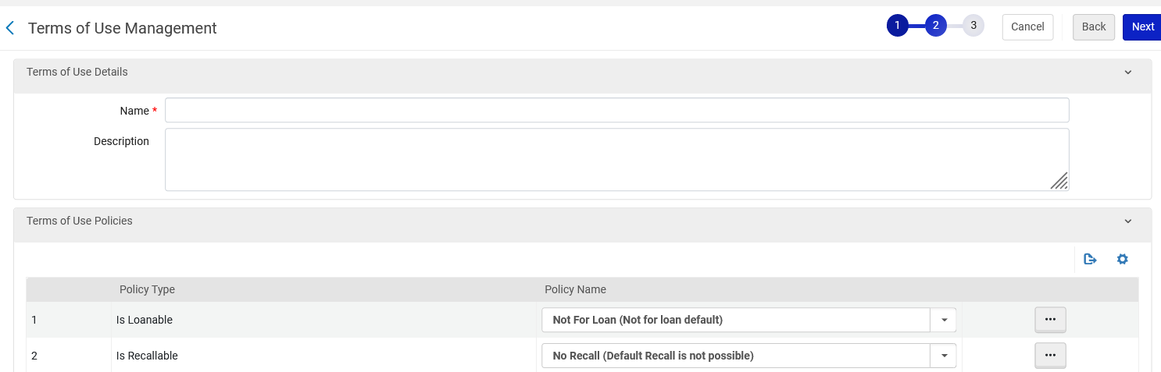
The configuration - step 3

Slide 19
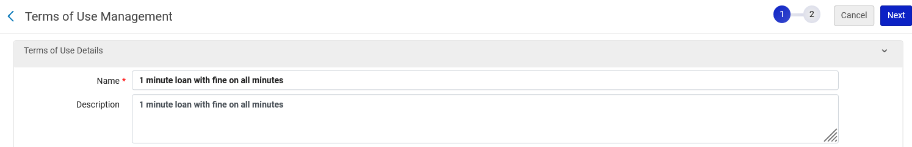
The configuration - step 3
We will fill in the Terms of Use Details as follows:

Slide 20
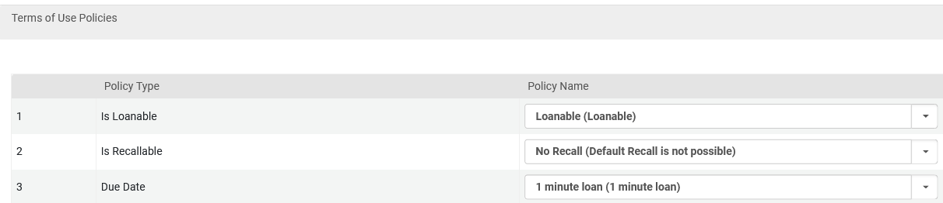
The configuration - step 3
We will fill in the Terms of Use Policies as follows:
This is the "advanced policy configuration" of type "Due Date" which we created in step 1.
Item is Loanable
This is the "advanced policy configuration" of type "Overdue Fine" which we created in step 2.

Slide 21
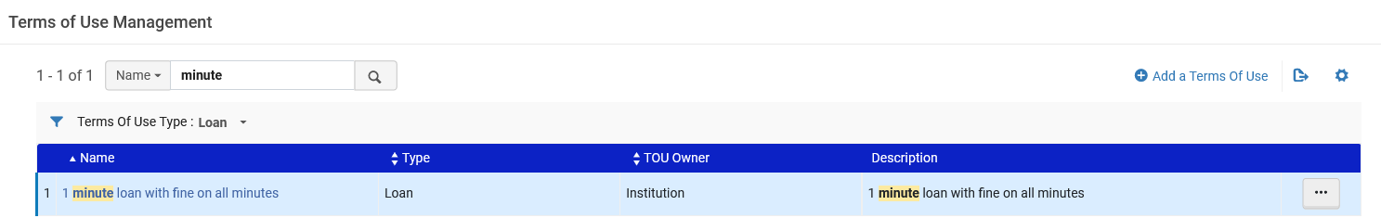
The configuration - step 3
We have done step 3 and defined a Terms of Use of type "Loan" called "1 minute loan with fine on all minutes".

Slide 22
The configuration - step 4

Slide 23
The configuration - step 4
Step 4: Create an Item Policy called "1 Minute Loan With Overdue Fine"
This is done at "Configuration > Fulfillment > Physical Fulfillment > Item Policy > click 'Add Row'".
We receive the "Add Row" box which appears on the next screen.

Slide 24
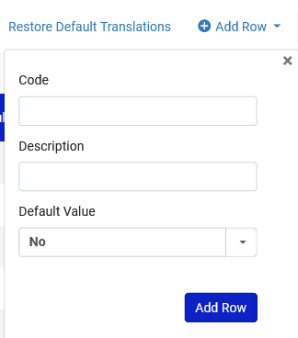
The configuration - step 4

Slide 25
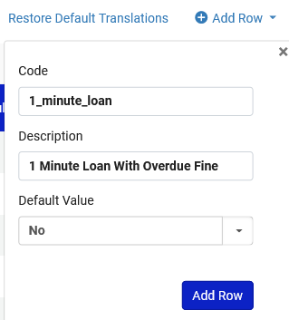
The configuration - step 4
We will fill in as follows:

Slide 26
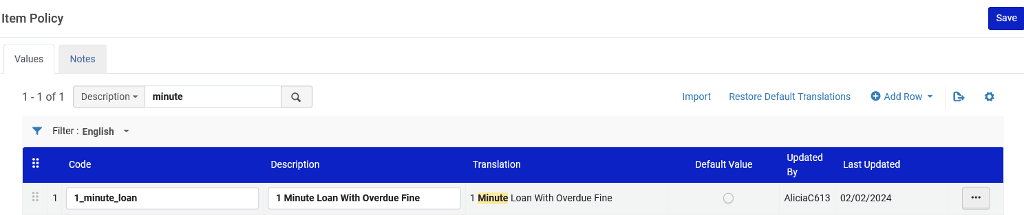
The configuration - step 4
We have done step 4 and defined an "Item Policy" called "1 Minute Loan With Overdue Fine"

Slide 27
The configuration - step 5

Slide 28
The configuration - step 5
Step 5: Make a fulfillment unit rule which uses the above terms of use "1 minute loan with fine on all minutes"
This is done at "Configuration > Fulfillment > Physical Fulfillment > Fulfillment Units > Edit the relevant Fulfillment Unit (which contains the locations of items to which the rule will apply) > switch to tab 'Fulfillment Unit Rules' > select Rule Type "Loan" > click 'Add Rule'".
We receive the "Fulfillment Unit Rules Editor" page which appears on the next screen.

Slide 29
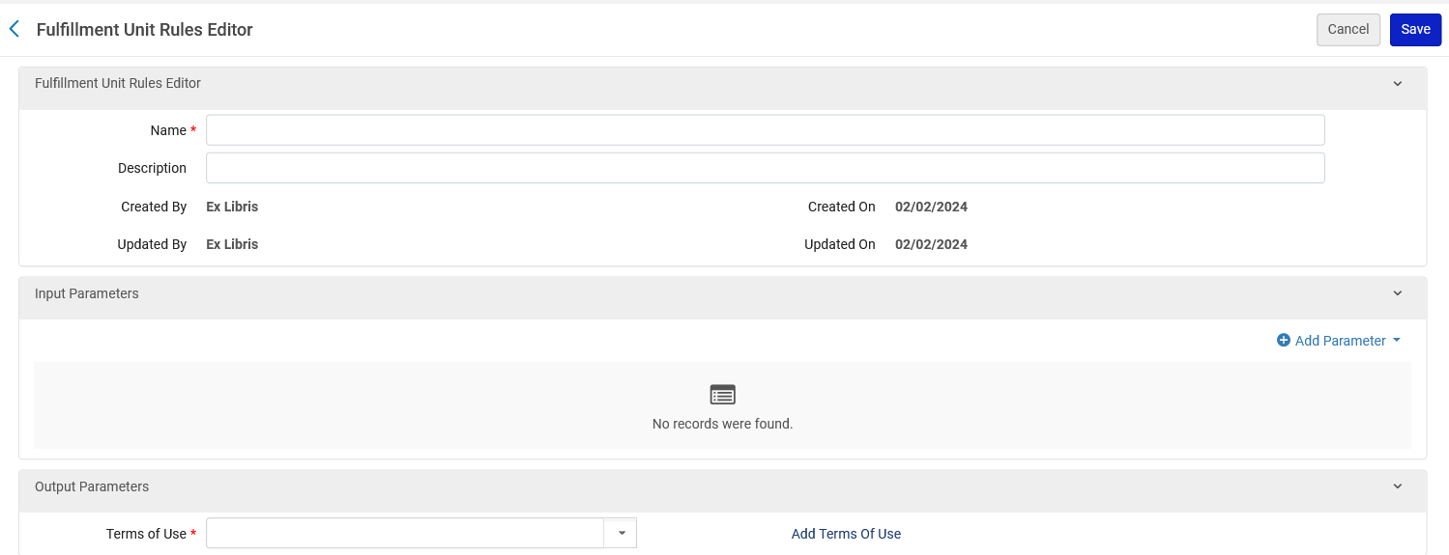
The configuration - step 5

Slide 30
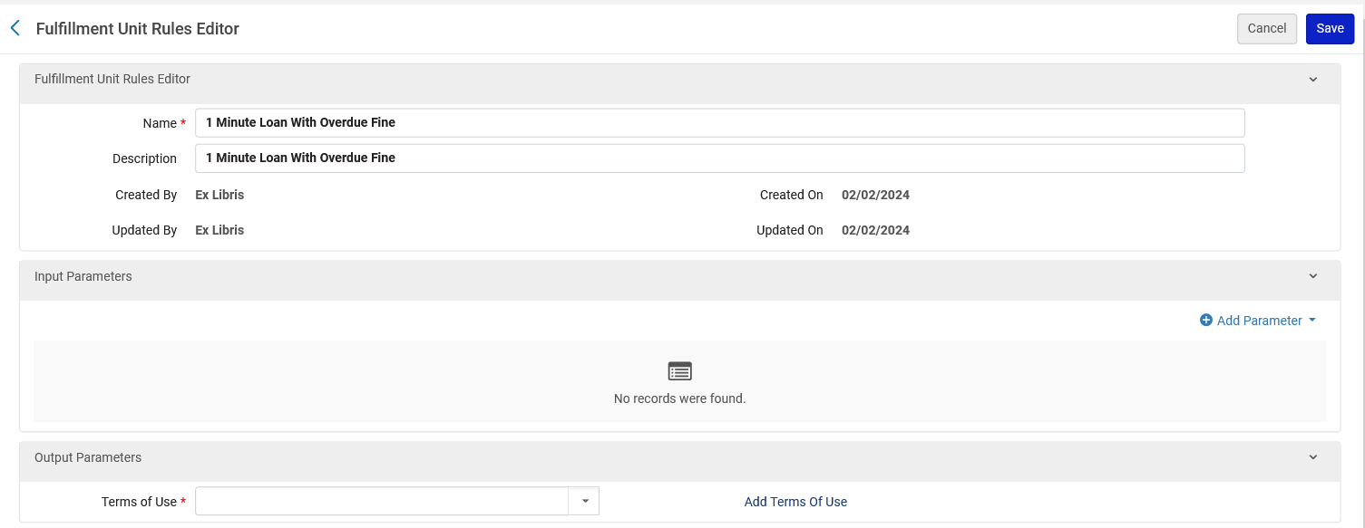
The configuration - step 5
We will call the rule "1 Minute Loan With Overdue Fine"
We will give it the same description
Now we will click "Add Parameter"

Slide 31
The configuration - step 5
After clicking "Add parameter" we define the conditions for the rule.
We will state: If the item policy = "1 Minute Loan With Overdue Fine" then use Terms of Use "1 minute loan with fine on all minutes"

Slide 32
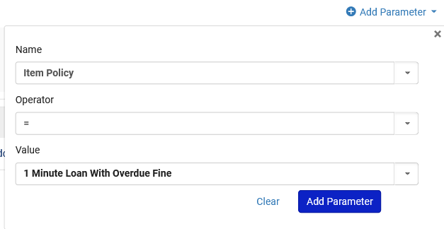
The configuration - step 5
After clicking "Add parameter":
We could have used many other parameters here such as item location or patron user group

Slide 33
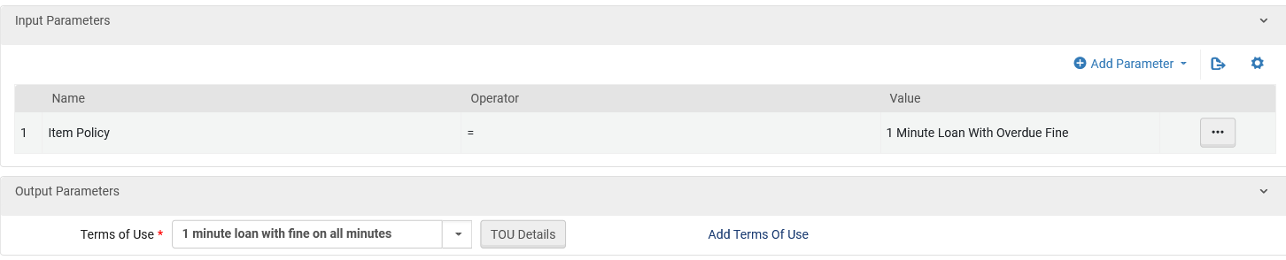
The configuration - step 5
Now we choose the Terms of Use which we previously made

Slide 34
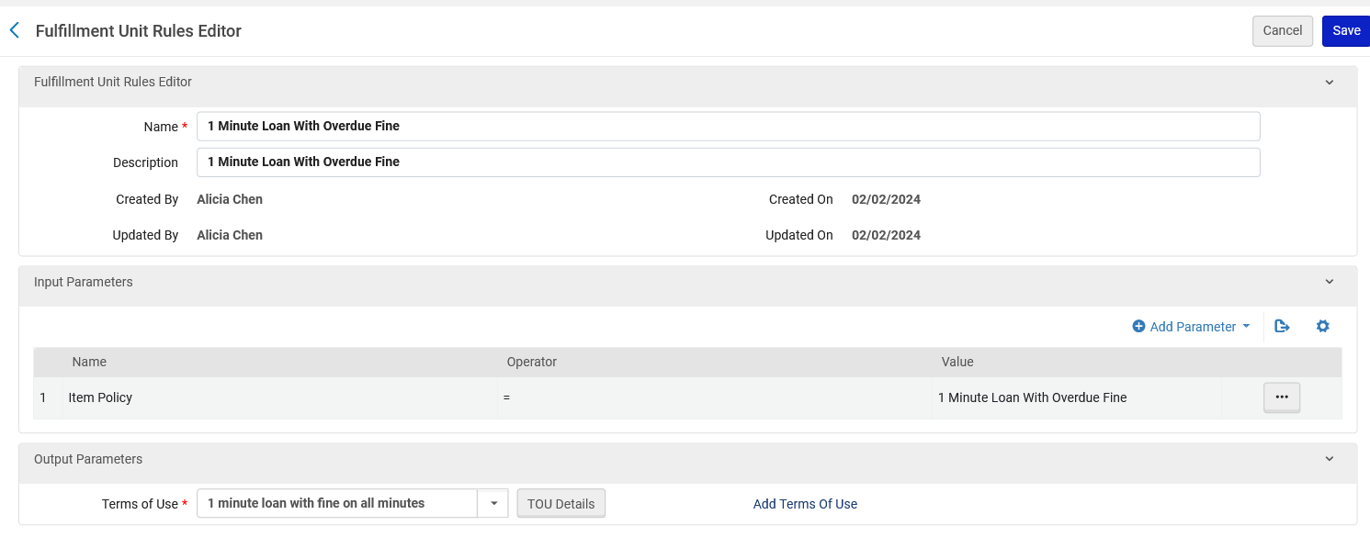
The configuration - step 5
Here is the rule
If the condition in the "Input Parameters" exists, then use the Terms of Use on the "Output Parameters"

Slide 35
Test the Fulfillment Unit rule

Slide 36
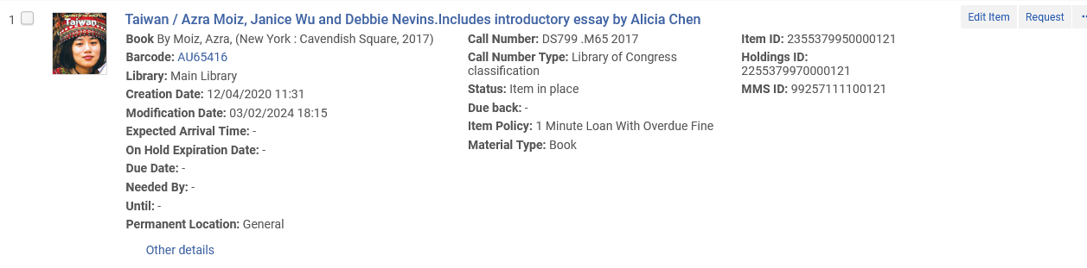
Test the Fulfillment Unit rule
Barcode AU65416 is in the Main Library General Location, which is part of the Fulfillment Unit in which we made the Loan rule.
It has item policy "1 minute loan with overdue fine"

Slide 37
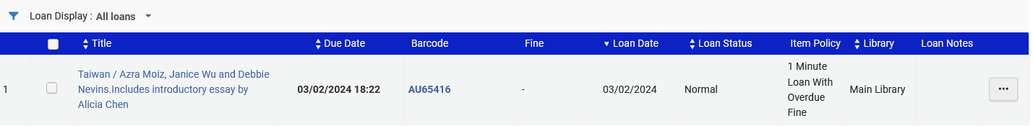
Test the Fulfillment Unit rule
We loan this item to patron Aaron Hacohen.
It is loaned Feb. 03 at 18:21 and has a Due Date of Feb. 03 at 18:22.
It is correctly loaned for a period of 1 minute
No fine yet

Slide 38
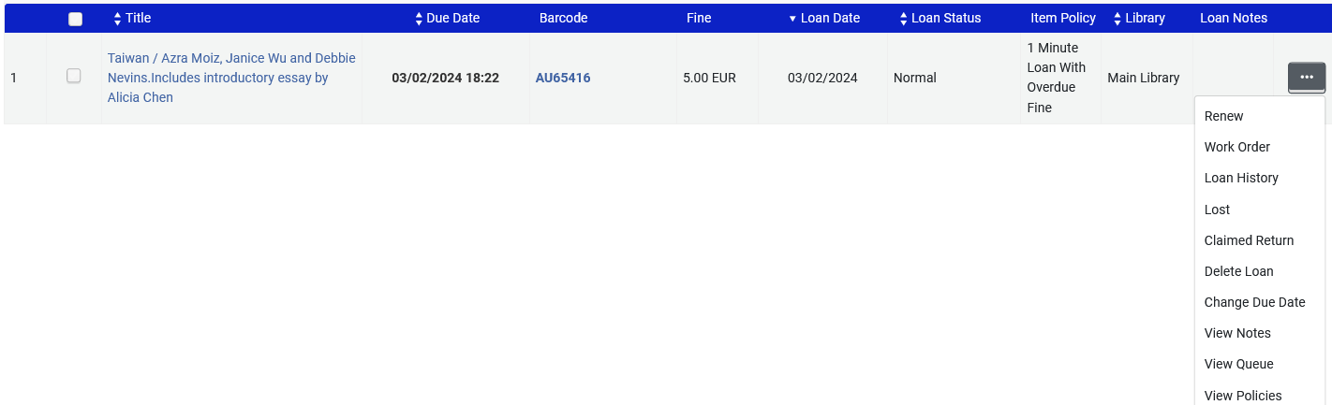
Test the Fulfillment Unit rule
Let's look at the Loan History

Slide 39
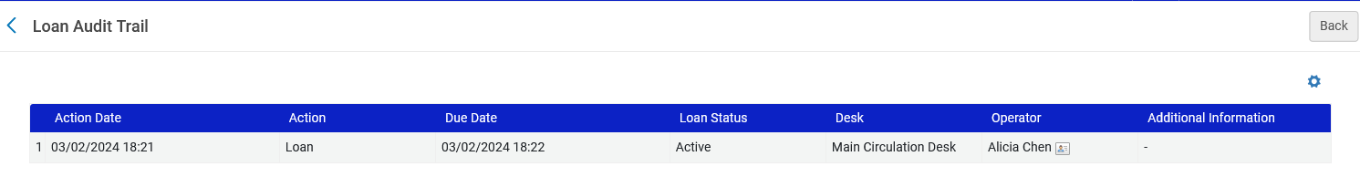
Test the Fulfillment Unit rule
Let's look at the Loan History.
Loaned at 18:21 and Due at 18:22

Slide 40
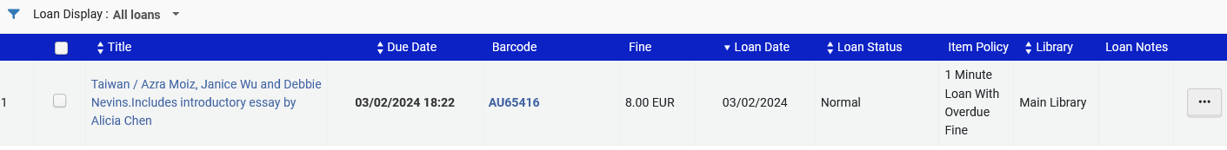
Test the Fulfillment Unit rule
As the minutes go by the fine is accruing, it is already 8 units of currency.

Slide 41
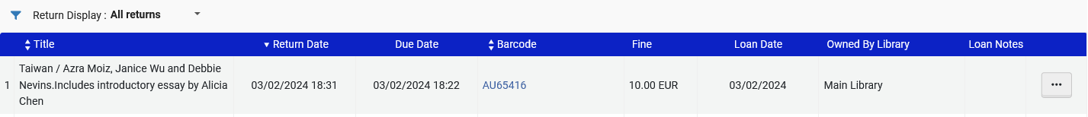
Test the Fulfillment Unit rule
We return the item and see the return history.
It was Due at 18:22 and returned at 18:31.
It therefore has a fine of 10:00 units of currency
Note that the calculation is not "31-22" which equals 9, because "22" is also part of the overdue time, thus it is "10". (there are 10 overdue minutes: 22, 23, 24, 25, 26, 27, 28, 29, 30, 31)

